Slide 1

Optical communications and data networks (EENGM2001) Week13_Lecture004_ASync_Coherence
Siddarth K Joshi

Slide 2
Coherence
Waves are coherent if they have the same:
Wavelength (i.e. frequency)
Phase
Polarisation
Coherent waves will interfere constructively.
Perfect monochromatic (i.e. single frequency light) will remain coherent forever!
Perfect monochromatic light is not possible!
The best lasers have spectral linewidths of < mHz.

Slide 3
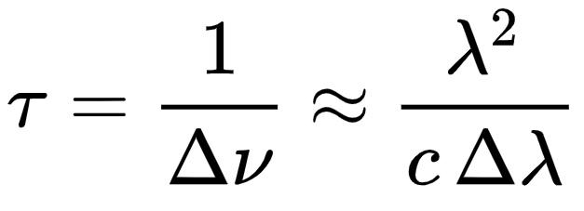
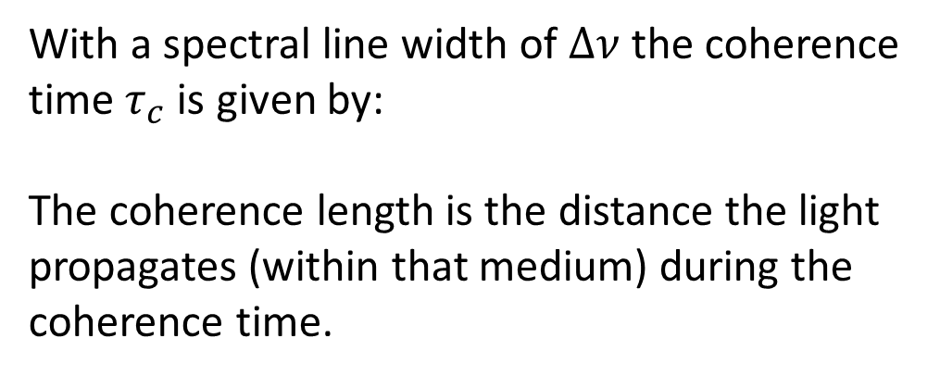
Coherence
If a beam of light is not monochromatic then different frequencies will interfere.
(This is called? Answer in the quiz)
With a spectral line width of $Δν$ the coherence time $τ_{c}$ is given by:
The coherence length is the distance the light propagates (within that medium) during the coherence time.
c

Slide 4
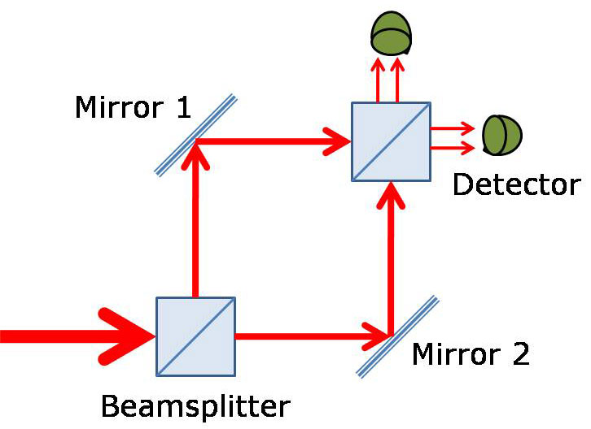
Coherence
Coherence means perfect constructive interference.
Incoherence means rapid random interference.
Input power = P_{in}
Perfect interference means that D₁ receives P_{in} &
D₂ receives zero. (in absence of losses).
Perfect destructive interference:
both detectors receive 0
D₁
D₂

Slide 5
Coherence
Assume a coherence length of 1m.
The lengths of the paths are shown in the figure.
Will this result in constructive or destructive interference?
Hint, Phase is relative, thus Coherence is relative and only the path length difference matters.
D₁
1m
D₂
2m
1m
2m

Slide 6
Coherence
Assume a coherence length of 1m.
The lengths of the paths are shown in the figure.
Will this result in constructive or destructive interference?
Note the path lengths have changed?
D₁
2m
D₂
2m
1m
1m

Slide 7
Coherence
Why is coherence and interference important?
Interference is the best way to detect (i.e. receive) phase encoding
Understanding interference and what causes it is important to minimising inter symbol interference and achieving fast data rates.
Simple problem:
Calculate the line width of a laser with coherence length 10mm. Express the answer in nm.
More realistic problem:
What will be the signal loss passing through a lossless 50GHz optical filter with a perfect flat top profile?
The more realistic problem is something we will address later in the course. It is a common real life problem for a telecom engineer

Slide 8
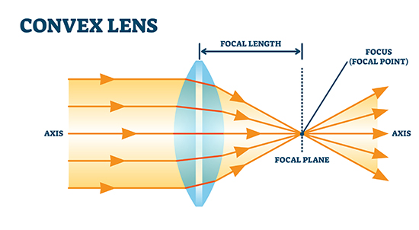
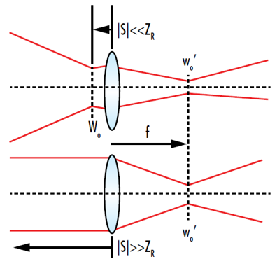
Gaussian optics
In Ray optics the focus is a point.
This is not realistic.
The Focus can never be a point. It has a minimum spot size.
We will not learn gaussian optics in this course. But you must be aware it exists and of some important results.

Slide 9
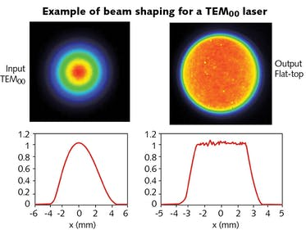
Beam Divergence
An ideal beam of light has a gaussian cross section.
The beam spot size is defined as the distance from the centre of the beam where the intensity falls to 1/e² of the value at the centre
A gaussian beam extends to infinity. (If there is a finite aperture, then the beam profile is only approximately gaussian)
Notes:
https://en.wikipedia.org/wiki/Gaussian_function

Slide 10
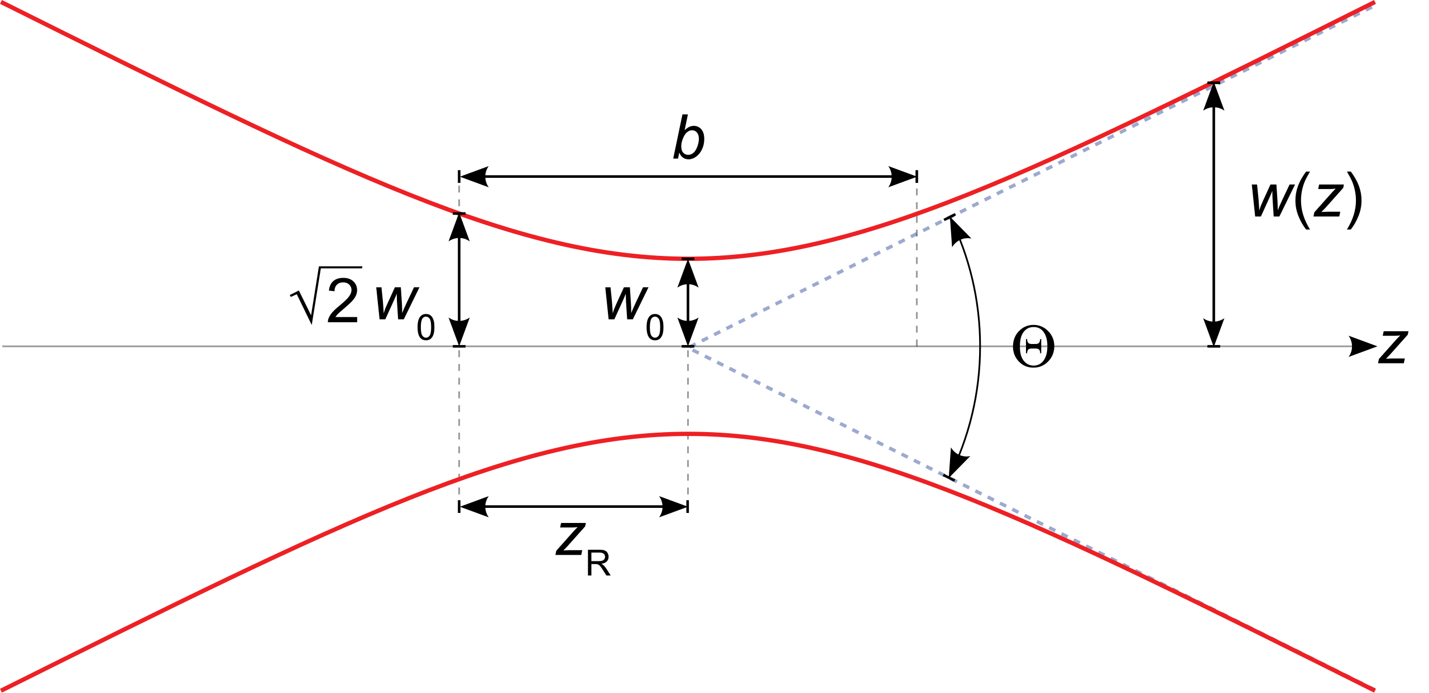
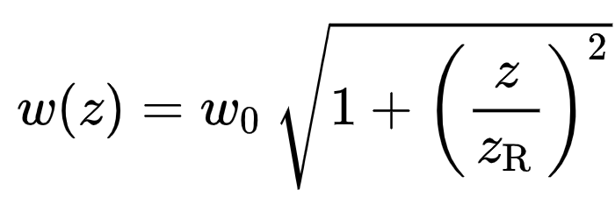
Beam Divergence
Any beam of light (even if collimated) will eventually diverge.
For a collimated beam w₀ is the radius of the transmit aperture.
At a distance z the beam radius is w(z)
Z=0 is defined as the location of w₀

Slide 11
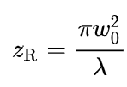
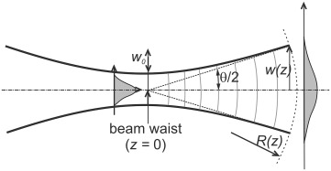
Beam Divergence
Rayleigh range Z_{R} is the distance for which the beam spot size is approximately constant.
Think of this as half the length of the focal point

Slide 12
Beam Divergence
Why is this important?
To couple light into and out of an optical fibre
Free space optical communication (including satellites)
Understanding waveguides, Beam splitters, evanescent coupling, cross talk, etc.
Problem:
Consider an optical communication terminal on a satellite with a very large 20cm transmit aperture for the telescope. This satellite is sending an optical signal to another satellite with the same sized receiving aperture (20cm). If the second satellite is 1000 km away what is the total optical loss in dB.
Note: The correct way to do this calculation is to integrate a gaussian function within the limits of the receiver aperture. Those interested can try this on their computers. However, to simplify the calculations let us assume that the beam that reaches the receiver has a flat top profile. (i.e. the radial cross section of the intensity is constant and does not follow a gaussian distribution)
Hint: If you calculate the beam expansion in just one dimension you will nor get the complete answer. Remember that the beam has a circular cross section. So you need to consider the total area of the beam and the total area of the receive aperture.

